Slide 1

THAT IS ALSO NOT MY RJ45 JACK!
IRL NETWORKING FOR HUMANS, Pt. 2
J0hnny Xmas | @j0hnnyXm4s

Slide 2
Part 1 Recap
The Game is Real
The Only Way to Win is to Play
Showing Up is Really Hard
Nobody likes to wear pants
Keep a social calendar
COMMIT.

Slide 3
Part 1 Recap
Networking is a skill
. . .which also makes it an art
Like all skills & arts, it takes practice
Your goal is comfort and CONFIDENCE
You will fail. A lot. This is great.
Review, adjust, retest, review, adjust, retest

Slide 4
CONFIDENCE IS KEY

Slide 5
ANYWAY, I showed up. Now what?
WORK THE ROOM
WORK THE ROOM
WORK THE ROOM
WORK THE ROOM
WORK THE ROOM
WORK THE ROOM
IF THAT FAILS, TRY WORKING THE ROOM

Slide 6
ANYWAY, I’m here. Now what?
WORK THE ROOM
WORK THE ROOM
Put your phone / laptop / Google Glass / away
Stand up / Walk around
Open your eyes & stance; find your Happy Place

Slide 7
What You’re Doing Wrong
Wallflowering
Creeping on people \ conversations

Slide 8
THE JOHNNY XMAS GRAND UNIFIED CREEPINESS THEORY
(using the standard 1-10 scale for all values)

Slide 9
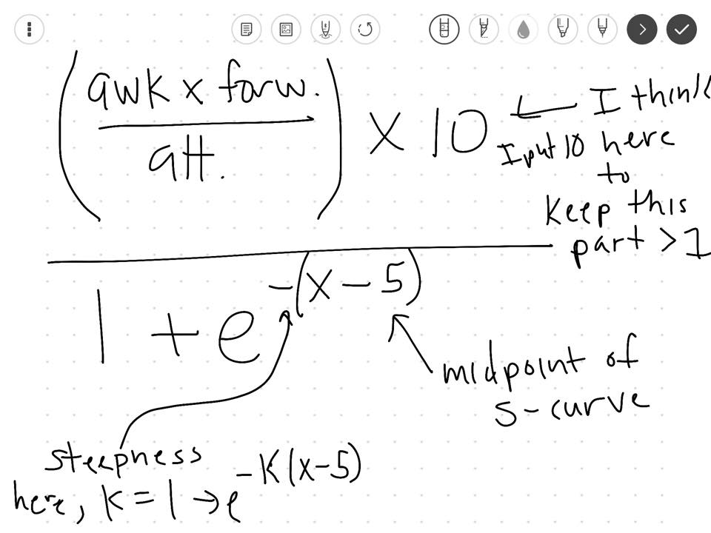

Slide 10
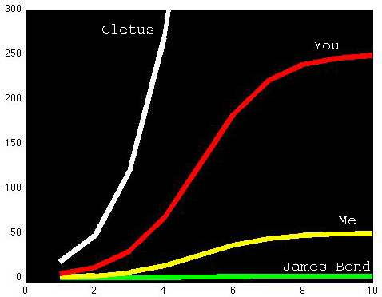
Notes:
IT’S ALL SUBJECTIVE. We will all creep someone out.

Slide 11
I’m Creepy. Now what?
Find the largest group of people, and integrate
Fill in a conversational lull with a personal experience
People love stories about failure
Match the energy of the group
Solo walk-ups
Ask about an aspect that stands out
Laptop stickers, new phone, shoes?

Slide 12
What You’re Doing Wrong
Wallflowering
Creeping on people \ conversations
Being constantly negative
Talking shop \ About work
This is OK if someone else initiates it, and you know what you’re talking about
Also share positive work stuff
Notes:
Which leads us to “nobody wants to actually listen to you”

Slide 13
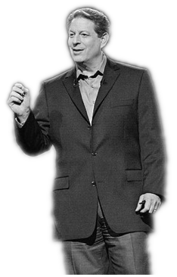
INCONVENIENT TRUTH #3:
Nobody Wants to Listen to You
Notes:
We are selfish creatures. We want to be loved. We want people to think we’re cool.

Slide 14
INCONVENIENT TRUTH #3
The more someone talks to (not with) you, the more they will like you
So, MAKE them talk to you:
Ask probing questions
“Active Listening” (“Really? That’s Cool.”)
Don’t offer unsolicited advice; only sympathy.
Also, practice your empathy. Find your “zone.”

Slide 15
INCONVENIENT TRUTH #3
Do you talk too much? Look for these signs:
Minimal eye contact
Only responding with “Uh-huh. Yeah. Mmm-hmm.”
Not asking questions
Chicken Heading
Checking their phone
Talked to the same person for more than 15 minutes.
You’re drunk.

Slide 16
Help Me Not Suck!
Take improv classes
Try open mic standup comedy
Learn & perform street magic
Work other rooms besides tech meetups
Shared experiences:
Nightclubs \ Dance clubs
Bookstores
Art galleries \ Museums
Long lines

Slide 17

REQUIRED READING

Slide 18

REQUIRED READING

Slide 19
Fín
Johnny Xmas | @j0hnnyXm4s | https://github.com/johnnyxmas

